Slide 1
Virtual Assistant for the Blind
Project Phase – 1
(20CS713) – C20
Team Members:
T.Sree Nandhini Reddy (111720102162)
V.Chandrika Reddy (111720102167)
Mentor name:
Ms. Gayathri SM.E., Assistant Professor

Slide 2

ABSTRACT
In our world, individuals with visual impairments encounter significant challenges in their daily lives, particularly related to physical mobility and navigating unfamiliar surroundings. This project aims to develop a device serving as a personal assistant for visually impaired individuals. Its primary objective is to create an object detection system capable of recognizing objects at specific distances, benefiting the visually impaired and various commercial applications. This system combines various technologies, including image processing, speech processing, and deep learning using the You Only Look Once (YOLO) algorithm. It synthesizes voice announcements through text-to-speech (TTS) technology to provide object information audibly. These technologies are integrated into a single wearable solution: SMART GLASSES, connected to a mobile application that conveys information about recognized objects, substantially improving the quality of life for the visually impaired.

Slide 3
LITERATURE SURVEY
Several innovative projects have been developed by different teams. Rutuja Kukade's team created a multitasking Virtual Personal Assistant using voice commands and a Raspberry Pi. Ankush Yadav and colleagues introduced "Android-Based Object Recognition for the Visually Impaired," achieving a 95% accuracy with Faster RCNN. Freddy Poly's team built a real-time object detection system using ESP32 and ultrasonic sensors. Vipul Sharma's team developed a deep learning-based system for object, face, and speech recognition with a focus on affordability and portability. Weal A. Ezat proposed an experimental deep learning model with an 80.07% precision rate but limited to predefined objects. V. Balaji introduced a model for object detection, primarily for visually impaired users, with up to 95% accuracy. Dr. B. Harichandana's system transforms text into a digital format with approximately 90% accuracy, serving as an OCR solution.

Slide 4
PROBLEM STATEMENT
The problem at hand involves creating a comprehensive system designed to assist visually impaired individuals. This system should have the capability to not only detect various objects within their surroundings but also provide detailed audio descriptions of these objects. Moreover, it needs to calculate and communicate the distance between the blind person and the detected objects. By addressing these challenges, the goal is to enhance the safety, autonomy, and overall quality of life for individuals with visual impairments, allowing them to navigate their environment more effectively.

Slide 5
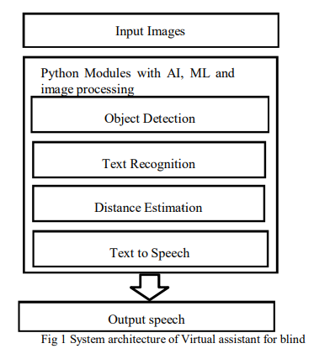
PROPOSED SYSTEM

Slide 6
IMPLEMENTATION
The virtual assistant comprises a Raspberry Pi camera and a text-to-speech API. The camera captures real-time images, and these images are trained using the COCO dataset. YOLOv3 is employed to process and detect objects in the images, which are then enclosed within bounding boxes. The Google Text-to-Speech API assists in reading images with text, and the GTTS module delivers voice-based guidance to individuals with visual impairments. The system accepts an image as input, processes it to identify objects, and calculates the approximate distance between the user and the object using ultrasonic sensors. Ultimately, the system provides an audio output to the user.

Slide 7
CONCLUSION AND FUTURE SCOPE
This paper introduces a modular solution aimed at enhancing daily activities by identifying obstacles in the path of visually impaired individuals and providing guidance. The virtual assistant effectively utilizes YOLOv3 for object detection. The system is currently composed of four modules: object recognition, text recognition, distance estimation, and text-to-speech. In the future, our virtual assistant aims to assist individuals with visual impairments or low vision by identifying objects ahead of them and offering distance estimations through audio output using a text-to-speech module.

Slide 8
REFERENCES
[1] Dr. B. Harichandana, Dr. C. Krishna Priya, Dr. P. Sumalatha, “Speech_Based Virtual Assistant System For VIsually Impaired People”, INTERNATIONAL JOURNAL OF MECHANICAL ENGINEERING, Vol.7 No.5, May, 2022
[2] Ankush Yadav, Aman Singh, Aniket Sharma, Ankur Sindhu, Umang Rastogi,Desktop Voice Assistant for Visually Impaired,International Journal of Recent Technology and Engineering (IJRTE), Volume-9 Issue-2, July 2020
[3] Mrs. J. Meenakshi, Dr. G. Thailambal,Object Recognition by Visually Impaired using machine learning:A study, International Journal of Mechanical Engineering,Vol. 6 No. 3 December, 2021
[4] Sagar Agrawal, Mandar Agrawal, Prof. Sagar Padiya, “Android Application with Platform Based OnVoice Recognition For Competitive Exam”, International Journal of Advanced Research in Science & Technology (IJARST),Volume 5, Issue 5, May 2020
[5] Ronald Maryan Rodriques, “Speak2Code: A Multi-Utility Program based on Speech Recognition that Allows you to Code Through Speech Commands ”,IJARSCT, Volume 3, Issue 1, March 2021.
[6] Avanish Vijaybahadur Yadav, Sanket Saheb Verma, Deepak Dinesh Singh,”VIRTUAL ASSISTANTFOR BLIND PEOPLE”, International Journal Of Advance Scientific Research And Engineering Trends, ||Volume 6 ,Issue 5 , May 2021.

Slide 9
